Slide 1
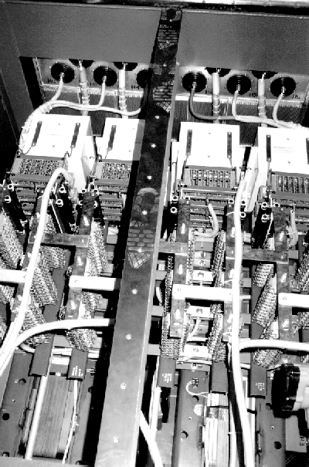
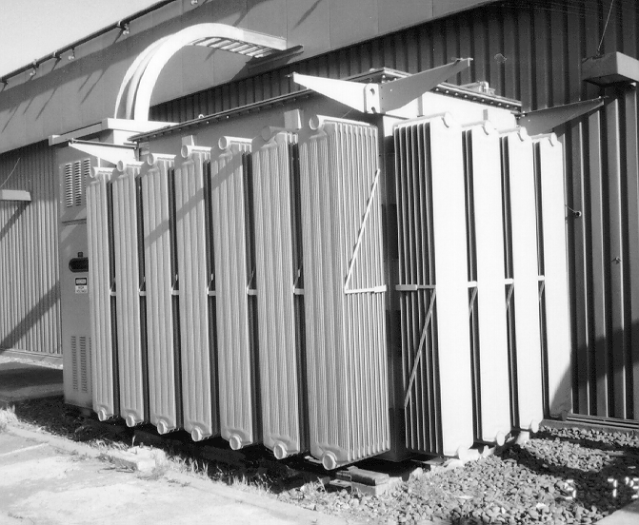

Pep II Power supply

Slide 2
Klystron Power Supply Specifications
90kV 27A DC Continues 2.5MW
Regulation & Ripple < ±0.5% @ >65kV.
Protect Klystron under Klystron Arc (Important).
Continues Control of Output Voltage.
Fit on existing transformer pads.
Cost effective.

Slide 3
Pep II Power supply

Slide 4
Pep II Power supply

Slide 5
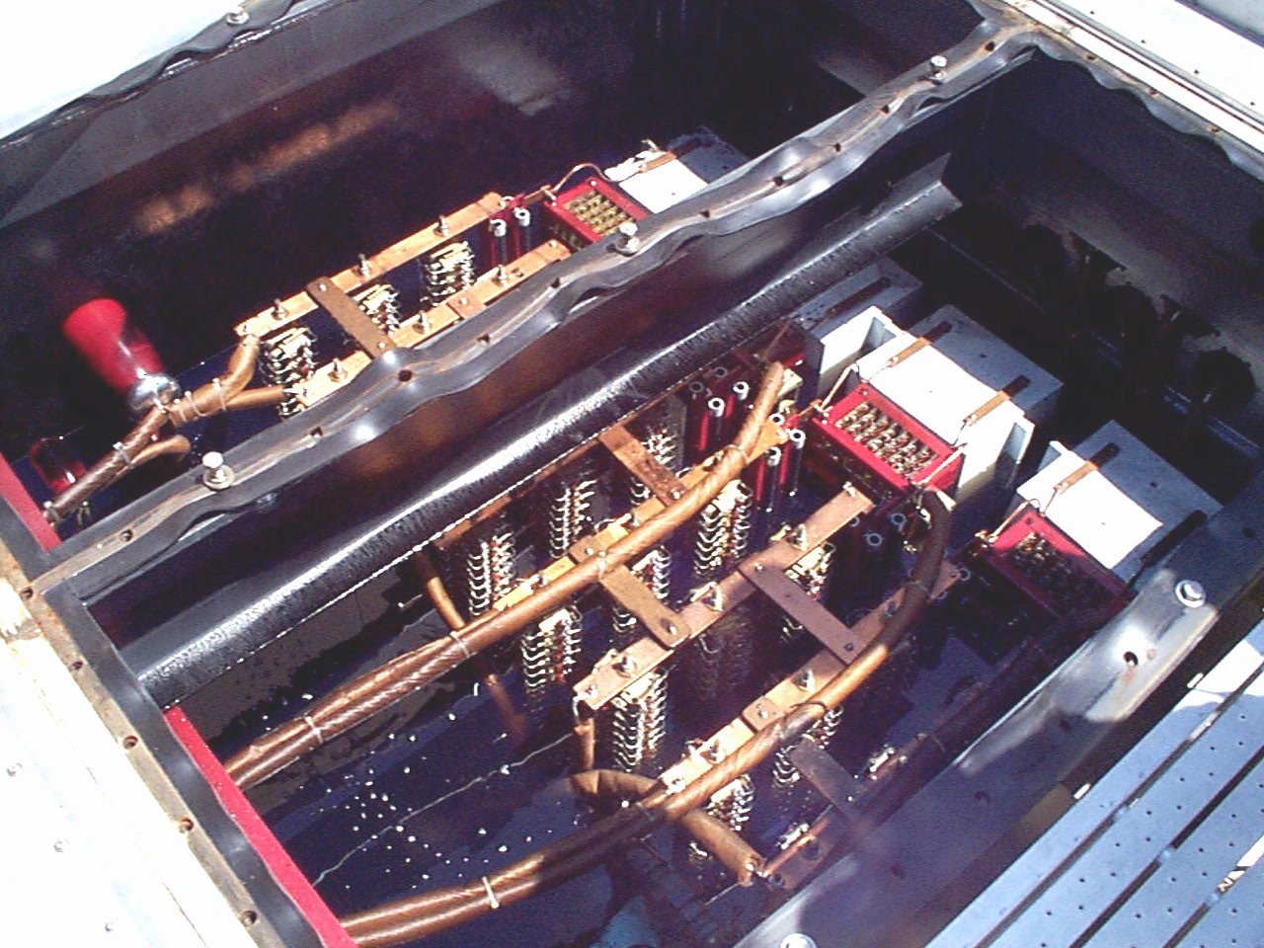
Pep II Power supply

Slide 6
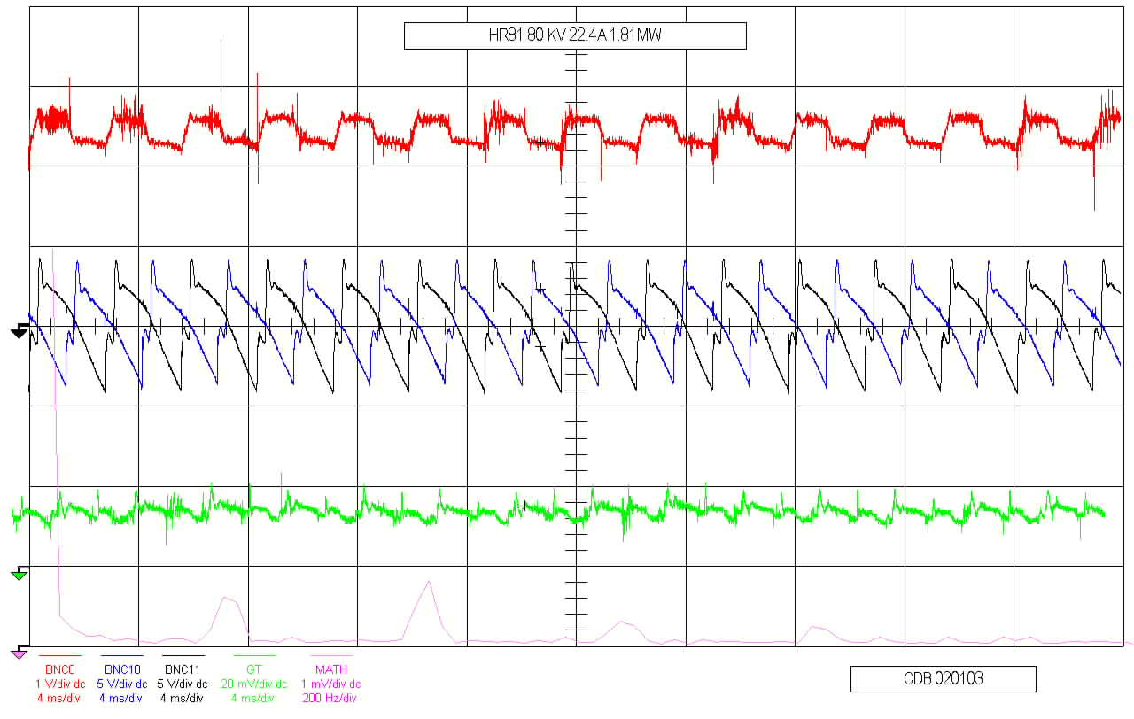
Pep II Power supply

Slide 7
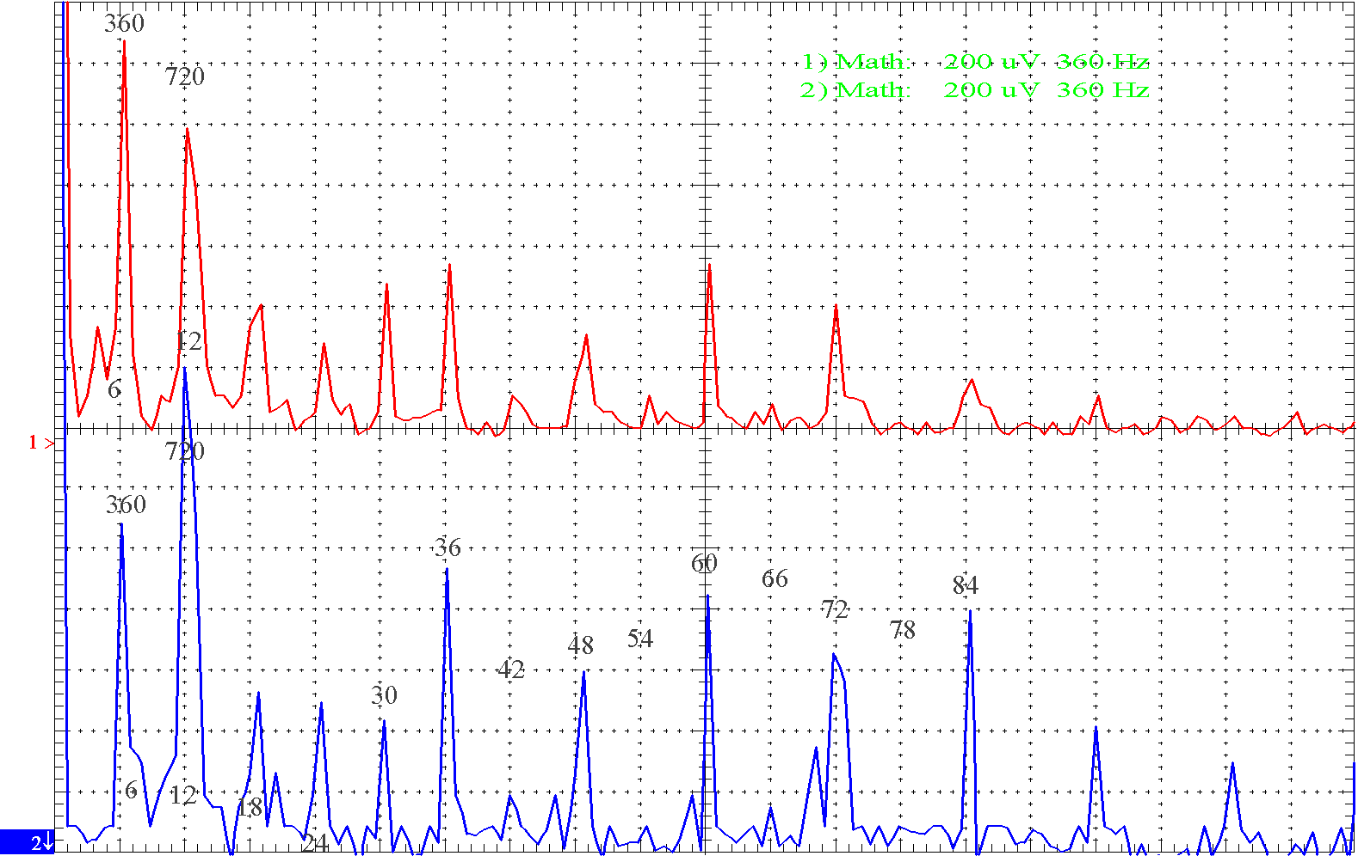
Pep II Power supply

Slide 8
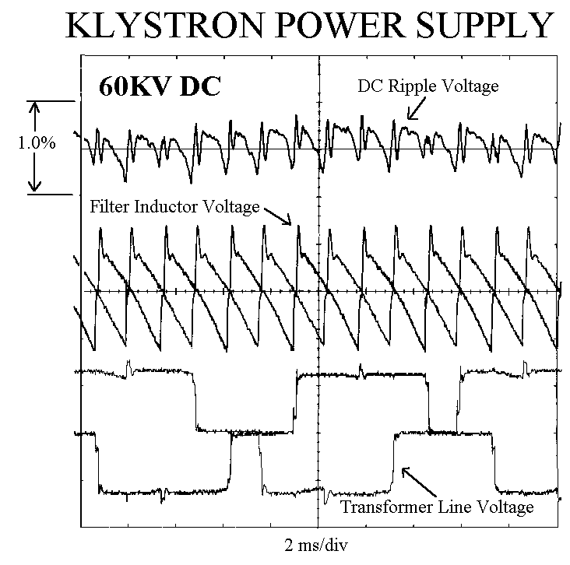
Pep II Power supply

Slide 9
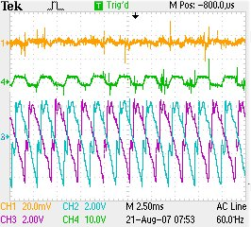
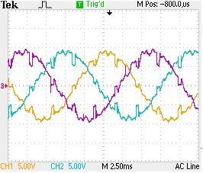
Power supply waveforms
Inductor voltage, Line current (AC)
Three Line Voltages (note overlap)

Slide 10
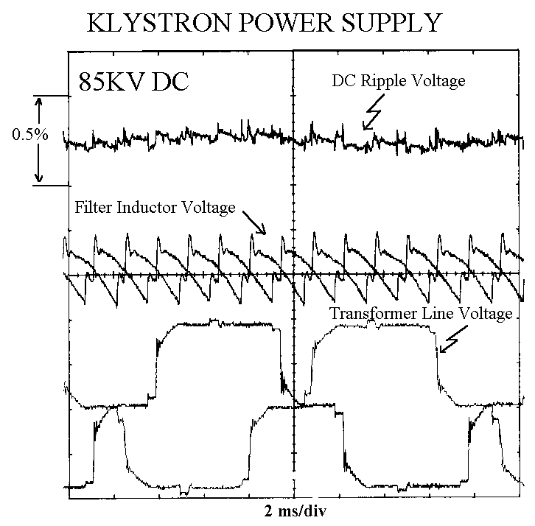
Pep II Power supply

Slide 11
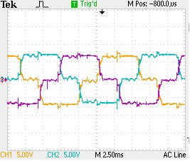
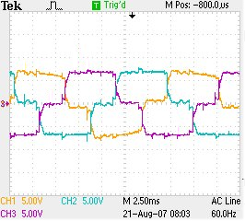
Transformer Phase Voltages
Three Core Voltages “Lower”
Three Core Voltages “Upper”

Slide 12
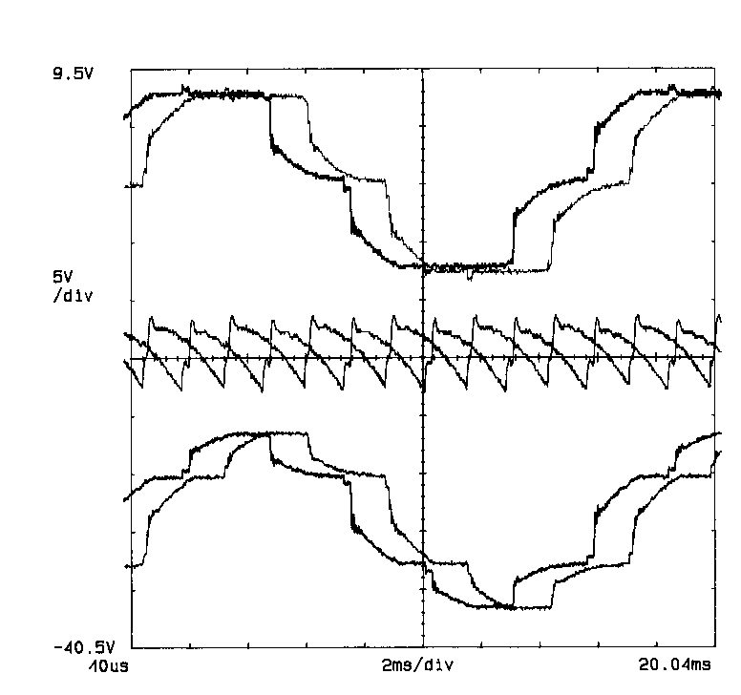
Pep II Power supply
AC CURRENT

Slide 13
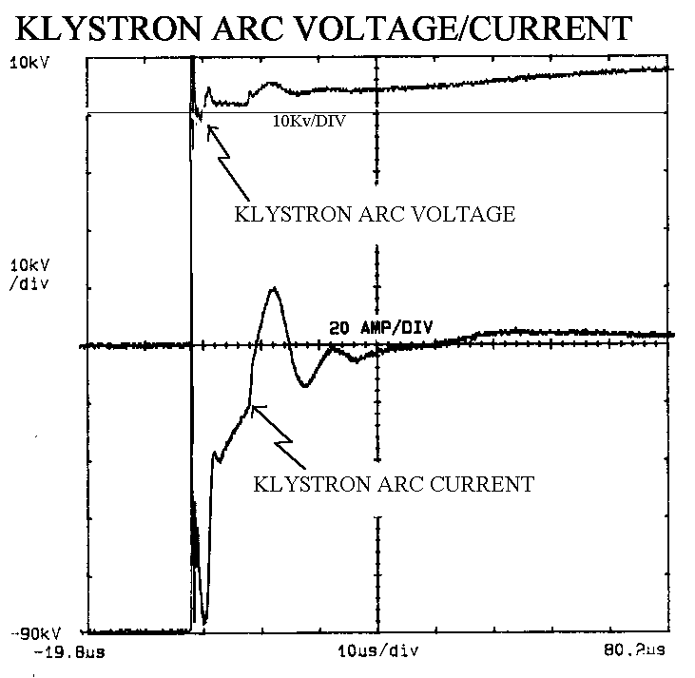
Pep II Power supply

Slide 14
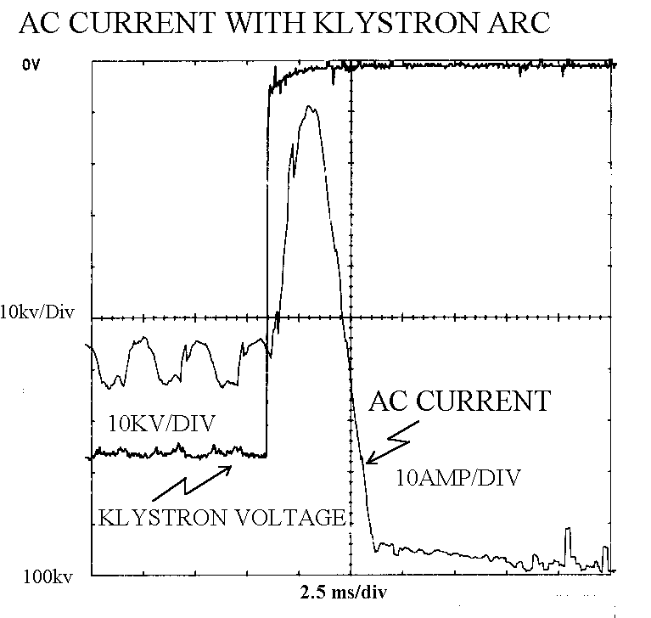
Pep II Power supply

Slide 15
Pep II Power supply
Light Triggered delay ~1 usec
Independent of Voltage

Slide 16
Present SCR Crowbar Delay
Present Crowbar Trigger
Normal and reversed driver

Slide 17
SCR Crowbar Trigger Delay
Normal SCR Triggered Crowbar
Light Triggered SCR Crowbar

Slide 18
Control wiring

Slide 19
Control wiring

Slide 20
Control wiring

Slide 21
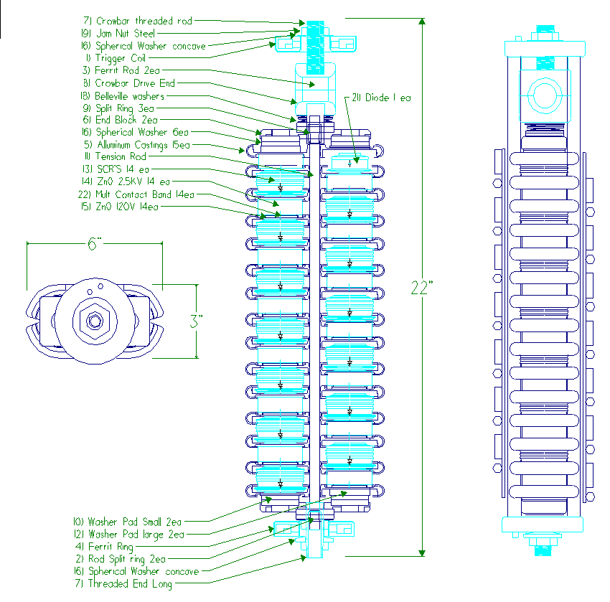
Control wiring

Slide 22
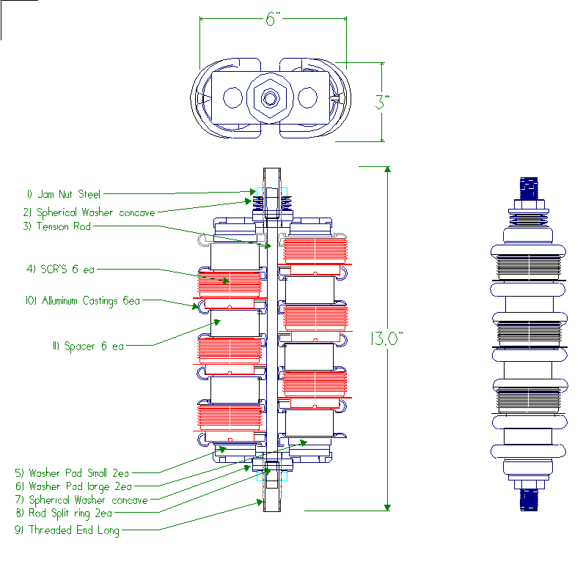
Control wiring

Slide 23
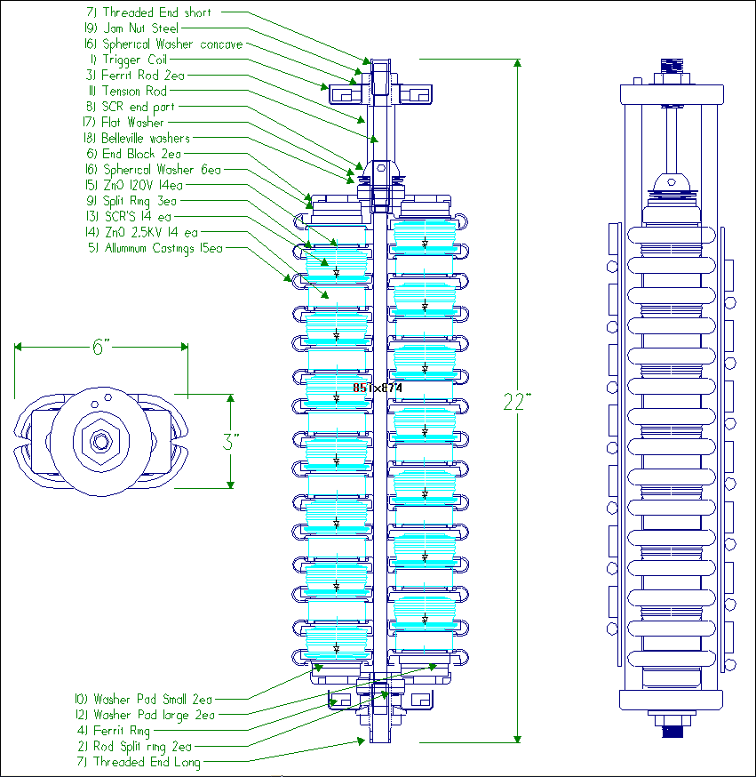
Control wiring

Slide 24
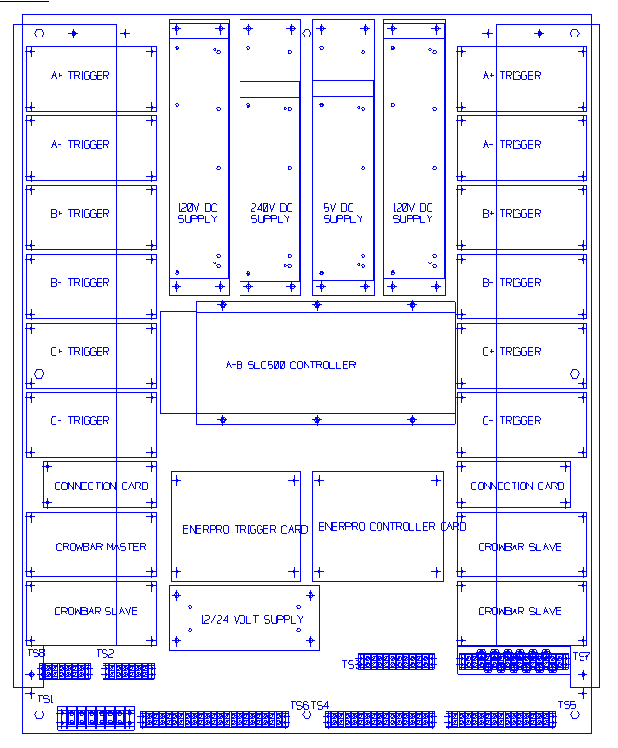
Control wiring

